Slide 1
TMDB Movies analysis
BY:- Rahul Mutalik

Slide 2
INTRODUCTION
Movies that cost over $100 million can still fail? Movie lovers have different interest
A production company wants to analyse a movie dataset to identify which movies are perform well in cinemas.
Which genre those movies belong too.
It will help the company predict if a movie will be commercial success.

Slide 3
Objective
Movies budget greater than 220,000.
Movies revenue greater than $961,000,000.
Movies with the highest revenue.
Movies with the lowest budget.
Does movies ratings effect the movie budget.
Top production companies.
Top 500 movies.
Movies with their run time for those movies that have above average run time.

Slide 4

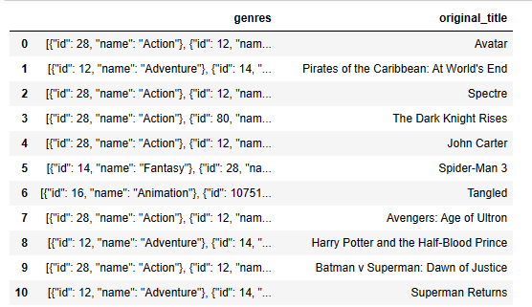
First 50 rows
List of first 50 rows of genre and title

Slide 5

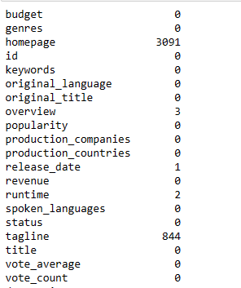
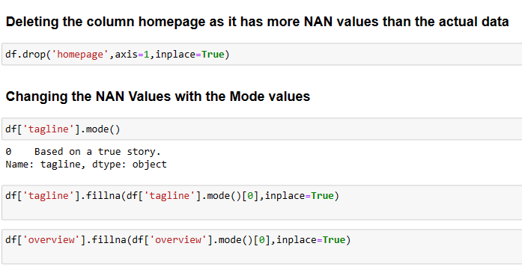
Null Value Identification
Home page , Tagline has most no of null values.

Slide 6

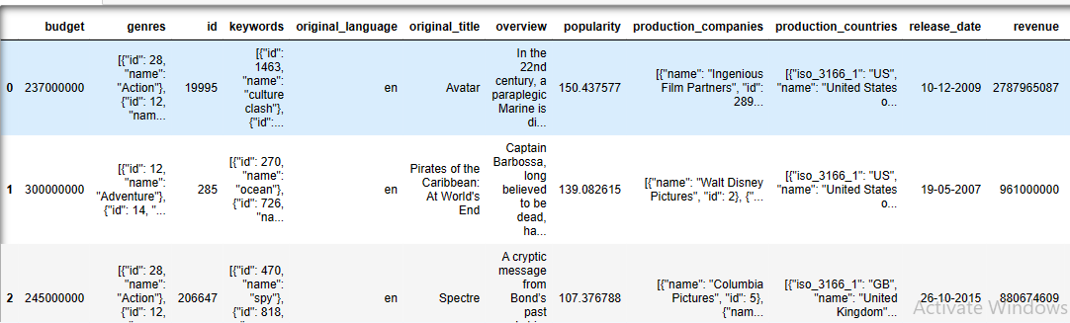
List of movies with budget greater than 2.2 Lakh

Slide 7
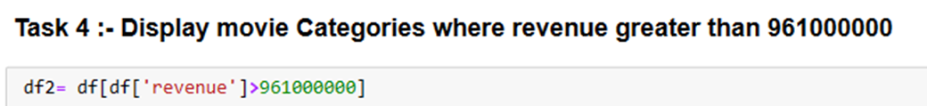
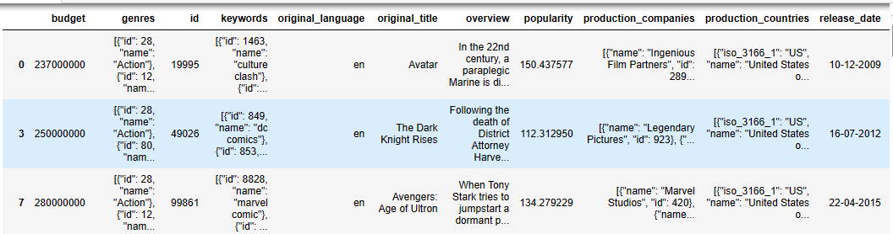
List of movies with budget greater than 961 million

Slide 8

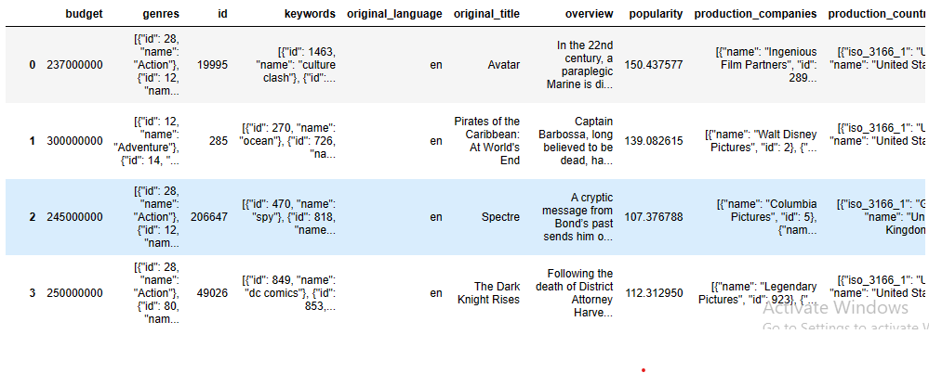
Deleting movies with no budget and revenue

Slide 9

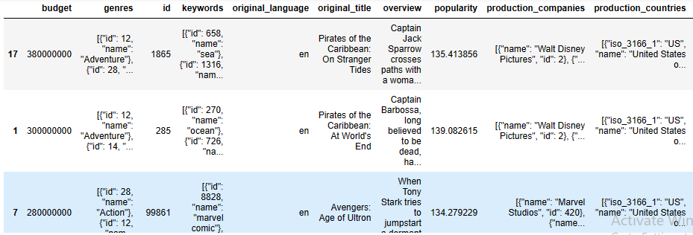
List of top movies highest revenue

Slide 10
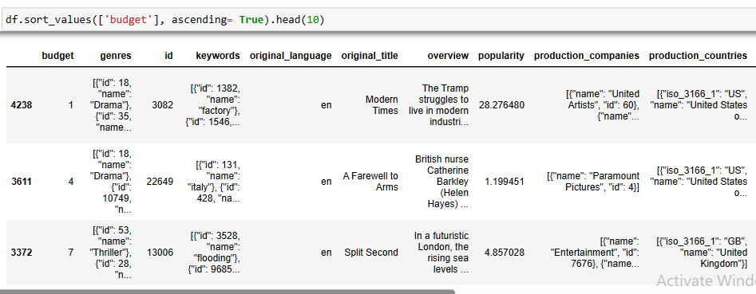
List of Bottom 10 movies by budget

Slide 11
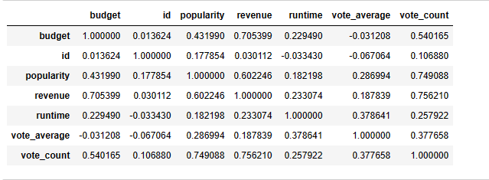
Budget and popularity correlation
Popularity and budget have low positive linear correlation.

Slide 12
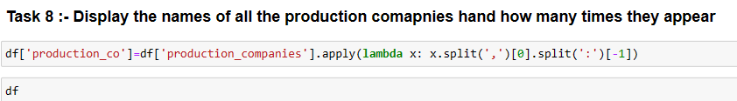

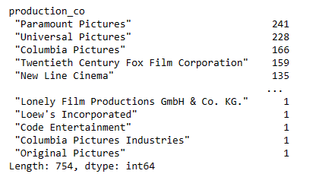
List of production companies with no of film produced
Paramount Pictures , universal
Pictures are the production companies which appear most no of times.

Slide 13

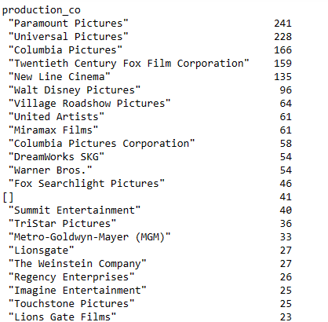
Top 25 production companies
List of production companies with their count of total movies produced.

Slide 14
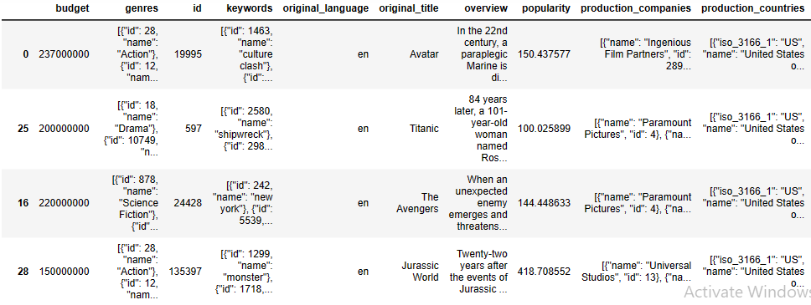
Top 500 Movies with highest revenue

Slide 15
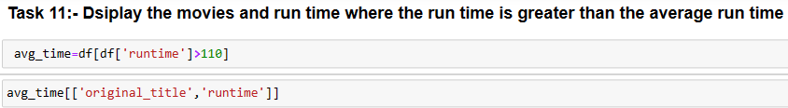
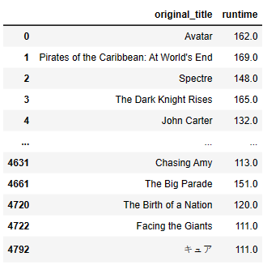
List of movies run time greater than average run time
Avatar,
Pirates of Caribbean: At world’s End make top of the list.

Slide 16
Insights
Avatar, Pirates of Caribbean: At world’s End make top of the list
Paramount Pictures , universal Pictures are the production companies which appear most no of times.
Popularity and budget have low positive linear correlation.
Recommendations
Actions movies are mostly liked.
Adventure movie type earn high revenue.

Slide 17
Thank you

